Slide 1
Shading models for plygons
Constant shading : known as flat shading
Valid if
Light source is infinity so N.L is constant
Viewer is infinity so N.V is constant
Polygon represents the actual surface being modeled
2) Interpolated Shading : illumination equation is applied to the vertex . Then it is interpolated
3) Polygon Mesh shading : Mach band effect

Slide 2
Characteristics Of Human Visual system
The human eye is nearly spherical and about 20mm in diameter.
The eye’s flexible lens is used to focus received light onto an area of the rear hemisphere of the eye, called the retina
The retina contains two different kinds of receptors : cones and rods
The 6-7 million cones are connected in the centre of the rear hemisphere of the eye; each one has an individual nerve connected to it.
The cones, which are sensitive only to relatively high light levels, are used to resolve fine detail
Rods are between 75 and 150 million rods distributed over the retina.
Several rods are connected to a single nerve; thus the rods cannot resolve fine detail.
The rods are sensitive to very low level of illumination.

Slide 3
Only Cones are used in perceiving color
Because the cones are sensitive only to relatively high levels of light, objects viewed with low illumination are seen only with the rods; hence they are not seen in color,
In the garden at night a red rose looks black or dark gray.
The eye’s sensitivity to brightness is logarithmic in nature
The total range of brightness sensitivity is very large, on the order of 10 10 , the eye can only respond to a smaller brightness range centered around a brightness adaptation level

Slide 4
The relative brightness range is on the order of 100—150 (2.2 log units) and the eye perceives brightness at the extremes of the relative brightness range as either black or white
Since the eye adapts to the average brightness in a scene ,an area of constant brightness or intensity surrounded by dark area is perceived to the be brighter or lighter than the same area surrounded by a light area
e.g. brightness of a single street light viewed against the sky during the day and at night.
The street light fades away in the day light because the relative brightness, and hence the contrast is lower in comparison to the contrast when the street light is seen at night
The brightness perceived by the eye tends to overshoot at the boundaries of constant brightness. This characteristics makes the areas of constant intensity appear as having varying intensity
This phenomenon is called the Mach band effect, which occurs whenever the slope of the light intensity curve changes abruptly.
The Mach band effect is particularly important for shading or rendering of polygonal surfaces.

Slide 5
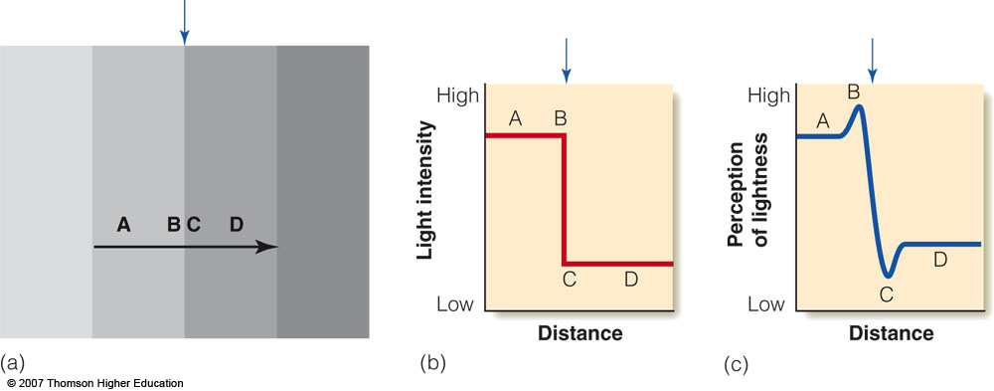
Figure 3.8 (a) Mach bands at a contour. Just to the left of the contour, near B, a faint light band can be perceived, and just to the right at C, a faint dark band can be perceived. (b) The physical intensity distribution of the light, as measured with a light meter. (c) A plot showing the perceptual effect described in (a). The bump in the curve at B indicates the light Mach band, and the dip in the curve at C indicates the dark Mach band. The bumps that represent our perception of the bands are not present in the physical intensity distribution.

Slide 6
People see an illusion of enhanced lightness and darkness at borders of light and dark areas
  All receptors are receiving lateral inhibition from neighbors
  In low and high intensity areas amount of inhibition is equal for all receptors
  Receptors on the border receive differential inhibition
  On the low intensity side, there is additional inhibition resulting in an enhanced dark band
  On the high intensity side, there is less inhibition resulting in an enhanced light band
  The resulting perception gives a boost for detecting contours of objects

Slide 7
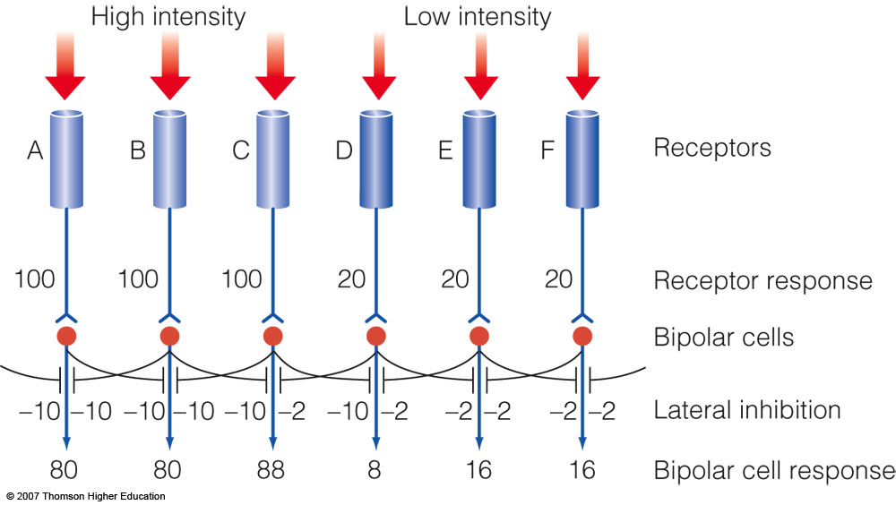

Slide 8
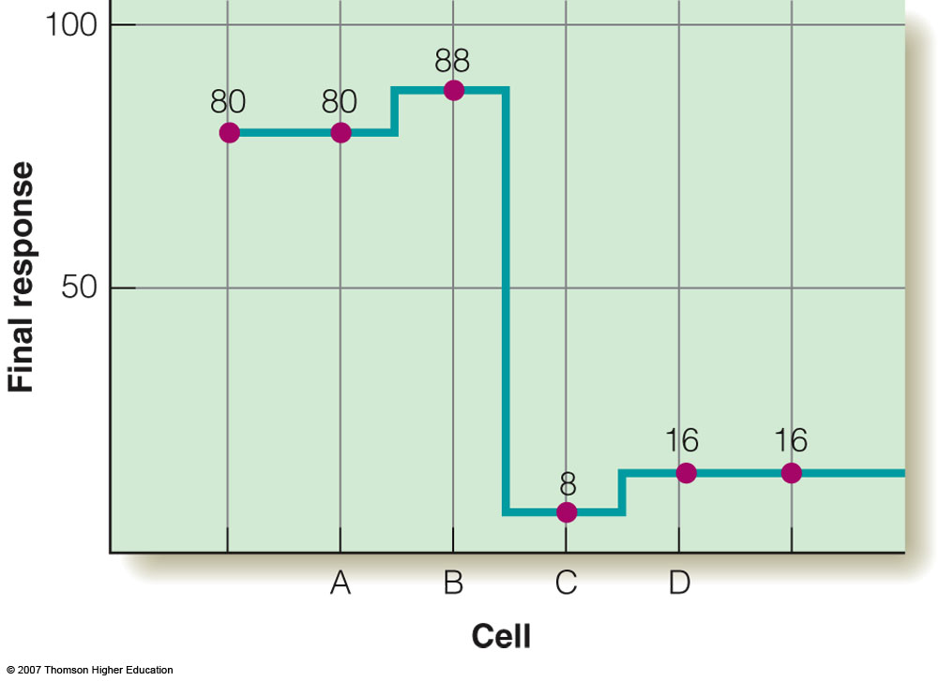
Figure 3.11 A plot showing the final receptor output calculated for the circuit of figure 3.10. The bump at B and the dip at C correspond to the light and dark Mach bands, respectively.

Slide 9
Gouraud shading
Also known as Intensity interpolation shading
Illumination equation is applied at vertices. Then intensity calculated at vertices are interpolated
Phong shading
Also known as normal-vector interpolation shading
Calculate normal at vertices and the interpolate it

Slide 10
Comparison Between Gourad shading and Phong shading
Gourd and phong both removes the faced appearance caused due to the intensity discontinuities associated with constant shading. But it suffers from Mach band effect
Both shading ensures only continuity of intensity across polygon boundaries but not continuity of change in intensity. But it is smaller in phong shading. But in case of sphere phong shading give more mach band effect
Phong shading produce more accurate results, because it finds normal at each point.
Phong shading is computationally more intensive, since the interpolated normal must be normalized every time it is used in an illumination model

Slide 11
If one vertex has highlight and other vertices have lower intensity, in case of gourad shading the intensity across the polygon is linearly interpolated between highlight intensity and the lower intensities , spreading the highlight over the polygon. In case of phong shading ,highlight is not spread.
If highlight fails to fall at a vertex, then gourad shading may miss it entirely since no interior point can be brighter than the brightest vertex from which it is interpolated
Both techniques render concave polygons incorrectly. Because it can give rise to a shading discontinuity.
Fast Phong shading
It require seven additions , six multiplications , one division and a square root for each pixel.
But combination of difference equations and lookup table increase speed
Taylor series expansion of phong shading increase speed

Slide 12
Problems with interpolated shading
(!) Curved surfaces can be properly shaded by breaking the surface into a greater number of smaller polygons , but at a corresponding increase in expense
(2 )orientation dependence : result is dependent on the orientation of the projected polygon’s orientation because values are interpolated between vertices and across horizontal scan lines , the results may differ when the polygon is rotated
This effect is obvious when the orientation changes slowly between successive frames of an animation
Problem can be solved by decomposing polygons into triangles
(3) problem at shared vertices shading discontinuities can occur when two adjacent polygons fail to share a vertex that lies along their common edge

Slide 13
(4) Vertex normal :if we find vertex normal by averaging the normal of the surfaces sharing vertex , all the vertex normal will be parallel to each other
So there is little or no variation in shade if the light source is distant. Subdividing the polygons further will solve the problem
Applying any shading models to planar or bicubic surfaces produces smooth , uniform surfaces. So we required variety of methods to simulate this missing surface detail
The fine detail on an object is generated using Texture mapping
Three approaches to adding surface texture
1) Projected texture 2) texture mapping 3) solid texture

Slide 14
Projected Texture
Imagine putting a plain object between a slide projector and the projection screen
The surfaces of the object that face the projector will be covered by the projected image.
If the image depicts wood grain then the affected surfaces will have the intricate wood texture superimposed onto its original shading
In computer graphics , projecting texture onto an object is effectively the inverse of projecting an object onto the view plane. View plane can be referred as the reference plane ,which contains a two dimensional texture definition called the texture map

Slide 15
The projection line that associates point P with its image P’ allows the shading of P to be determined of influenced by information in the texture map at location P’
We simply assign attributes of P’ to P. Net effect of this approach is to paint the color of the texture onto the object.

Slide 16
In Second approach we may interpolate between the color C’ of P’ and the original color C of P using (1-k)C + kC’ where 0<k<1.0
In third approach we may use a logical operation involving C and C’ to compute a new color for P
E.g. A texture are with magenta shades will appear unaltered if the original color is white , but it will take on red shades if the original is yellow
Projected texture is an effective tool when target surfaces are relatively flat and facing the reference plane.

Slide 17
In Mapping, transformation from one coordinate system to another is required
Two mappings are required
One is from texture space to object space , sometimes called surface parameterization . Second is from object space to image space.
If the texture pattern is defined in an orthogonal coordinate system ( u,v) in texture space , and the surface in a second orthogonal coordinates system (x, y, z) , represented in parametric space (theta ,phi) , then adding the texture pattern to the surface involves determining or specifying a mapping function between the two space, e.g. the mapping from texture space to parametric space is
Theta = f (u, v) phi = g ( u , v )
And the inverse mapping from parametric space to texture space is
U = r ( theta , phi )
V = s ( theta ,phi )
The mapping function is assumed to be linear
Theta = Au+ B phi = Cv + D
A, B ,C , D are obtained from the relationship between known points in the two coordinate systems

Slide 18
Bump mapping
Texture mapping affects a surface’s shading, but the surface continues to appear geometrically smooth
So Technique known as bump mapping that involves perturbing the surface normal before it is used in the illumination model , just as slight roughness in a surface would perturb the surface normal.
N = Ps X Pt
We can displace point P by adding to it the normalized normal scaled by a selected by a selected bump-map value B.
New point P’ = P + BN/| N|
Solid Texture
Weakness of projected texture and texture mapping is due to inherent mismatch between a two-dimensional texture map and a three dimensional surface.
In this approach we define texture using a three-dimensional texture space.
When rendering an object , we map a surface point p( x, y, z) to its coordinates (u, v, w) in the texture space. Information associated with this location is then used to control the shading of P.

Slide 19
slightly different techniques are used
Catmull’s curved surface subdivision algorithm : subdivides a surface patch until a sub patch covers a single pixel center. The parametric values of the center of the sub patch or the pixel center are then mapped into texture space, and the texture pattern at that point is used to determine the intensity of the pixel
however this point sampling technique leads to severe aliasing effects if texture pattern consists of alternate black and white pattern ,then all the centre points occur in the white areas of the texture
To solve this problem Catmull subdivides the texture pattern , along with the surface patch. When a sub patch is found that covers only a single pixel center , the average intensity in the associated texture sub patch is used to determine the pixel intensity

Slide 20
Shadows
So far we have assume that the process of shading a point on an object is unaffected by the rest of that object or by any other object.
But an object might in fact be shadowed by another object between it and a light source; might transmit light, allowing another object to be seen through it; or might reflect other objects, allowing another object to be seen because of it.
Visible surface algorithms determine which surfaces can be seen from the viewpoint ; shadow algorithms determine which surfaces can be seen from the light source.
Thus, visible surface and shadow algorithms are essentially the same.
The surfaces that are visible from the light source are not in shadow; those that are not visible from the light source are in shadow
When there are multiple light sources , a surface must be classified relative to each of them.
The addition of shadows to the illumination equation
I=kaIa + ∑SifattIp[kd(N.Li) + Ks(Ri.V)^{n} ]
Where Si = 0 if light i is blocked at this point
=1 if light I is not blocked at this point

Slide 21
Algorithms to compute shadows
Scan line generation of shadows
Scan line algorithm to interleave shadow and visible surface processing
Using a light source as a center of projection , the edges of polygons that might potentially cast shadows are projected onto the polygons intersecting the current scan line
When scan line crosses one of these shadow edges, the colors of the image pixels are modified accordingly
A brute force implementation of this algorithm must compute all n(n-1) projections of every polygon on every other polygon
Bouknight and Kelley instead use a clever preprocessing step in which all polygons are projected onto a sphere surrounding the light source , with the light source as centre of projection
Pairs of projection whose extents do not overlap can be eliminated
Then compute the projection from the light source of each polygon onto the plane of each of those polygons that they have determined it could shadow . When the shade for a span is computed , it is determine which part is in shadow.

Slide 22
2) A two pass object precision shadow algorithm
Atherton , Weiler and Greenberg have developed an algorithm that performs shadow determination before visible surface determination
They process the object description by using the same algorithm twice , once for the viewpoint and once for the light source
The results are then combined to determined the pieces of each visible part of a polygon that are lit by the light source, and the scene is scan converted.
The first step uses the visible surface algorithm (weiler atherton) to determine the visible or illuminated polygons from the light source direction . The illuminated polygons are saved, each of which is tagged with the identity of its parent polygon
the lit polygons are transformed back into the modeling coordinates and are merged with a copy of the original database
Hidden surface removal is then performed on a copy of this merged database from the viewpoint

Slide 23
Shadow Volume Algorithm
Frank Crow Developed a method for determining if a point on an object is in shadow called shadow volumes
Assuming polyhedral objects , a shadow volume is a semi-infinite region of space defined by lines from the light source passing through each vertex of the polygonal faces forming the polyhedral object
Each plane of the shadow volume has an outward facing normal associated with it
Crow clipped the shadow volume to the frustum of vision
Crow’s method of determining whether a visible surface is in shadow is based on apple’s concept of quantitative invisibility
A shadow surface is front facing with respect to an eye point if the direction of its outward normal is toward the eye point and back facing if away from the eye point
A front facing shadow surface , with respect to an eye point , adds +1 to the shadow depth count, whereas a back facing shadow surface cancels the effect of a front facing shadow surface and adds -1 to the shadow depth count

Slide 24
If the eye point is not itself in shadow then if a line from the eye point to a point in the scene intersects more front facing shadow surfaces then back facing shadow surface i.e. the shadow depth count is positive, it is in shadow.
If the eye point is itself in shadow, the shadow depth counter is initialized to the number of shadow volumes containing the eye point.
Two pass z-buffer algorithm
Two passes through a z-buffer algorithm , one for the viewer and one for the light source
The algorithm begins by calculating and storing the z-buffer for the image from the viewpoint of the light
Next, the z-buffer and the image are calculated from the viewpoint of the observer using a z-buffer algorithm with the following modification
Whenever a pixel is determined to be visible its object precision coordinates in the observer’s view (x0,y0,z0) are transformed into the coordinates in the light source's view (xo’,y0’,zo’).
The transformed coordinates xo’ and y0’ are used to select the value zL in the light source’s z-buffer to be compared with the transformed value z0’. If zL is closer to the light source than z0’ then point is under shadow

Slide 25
Transparency
The surface that transmit light can be transparent
We can usually see clearly through transparent materials , such as glass.
Rays are refracted (bent)
Non refractive transparency
Light rays are not bent as they pass through the surface.
Thus , whatever is visible on the line of sight through a transparent surface is also geometrically located on that line of sight
Although refraction less transparency is not realistic
Two different methods have been commonly used to approximate the way in which the colors of two objects are combined when one object is see through other
Interpolated transparency 2) filtered transparency
Interpolated transparency : Consider transparent polygon 1 is between the viewer and opaque polygon 2

Slide 26
Interpolated transparency determines the shade of a pixel in the intersection
of two polygon’s projections by linearly interpolating the individual shades calculated for the two polygons
I = (1-K_{t1})I 1 + K_{t1}I 2
The transmission coefficient Kt1 measures the transparency of polygon 1, and ranges between 0 and 1.
When kt1 is 0 , the polygon is opaque and transmits no light
When Kt1 is 1, the polygon is perfectly transparent and contributes nothing to the intensity I. the value 1-K_{t1} is called the polygon’s opacity.
Filtered transparency :
That treats a polygon as a transparent filter that selectively passes different wavelengths , it can be modeled by
I = I ₁ + K_{t1}O_{t} I ₂ where O_{t} is polygon 1’s transparency color.
A color filter may be modeled by choosing a different value of Ot for each λ

Slide 27
In above both method if additional transparent polygons are in front of these polygons , then the calculation is invoked recursively for polygons in back to front order , each time using the previously computed I as I ₂
Implementing transparency
Mammen describes how to render transparent objects properly in back to front order in a z buffer based system through the use of multiple rendering passes and additional memory
First, all the opaque objects are rendered using a conventional Z-buffer.
Then transparent objects are processed into a separate set of buffers that contain, for each pixel , a transparency value and a flag bit , in addition to the pixel’s color and z value.
Each flag bit is initialized to off and each z value is set to the closest possible value.
If a transparent object’s z value at a pixel is closer than the value in the opaque z buffer , but is more distant than that in the transparent z buffer, then the color , z value, and transparency are saved in the transparent buffers , and the flag bit is set.

Slide 28
After all objects have been processed, the transparent object buffers contain information for the most distant transparent object at each pixel whose flag bit is set
Information for flagged pixels is then blended with that in the original frame buffer and z buffer
A flagged pixel’s transparency z values replaces that in the opaque z buffer and the flag bit is reset.
This process is repeated to render successively closer objects at each pixel
Refractive transparency
It is difficult to implement because the geometrical and optical lines of slight are different
If refraction is considered in fig , object A is visible through the transparent object along the line of sight, if refraction is ignored object B is visible
Relation between the angle of incidence θi and the angle of refraction θt is given by Snell’s law
Sin θi /sin θt =ntλ/niλ

Slide 29
Where niλ and ntλ are the indices of refraction of the materials through which the light passes.
A material’s index of refraction is the ratio of the speed of light in a vacuum to the speed of light in the material
It varies with the wavelength of the light and even with temperature
A vacuum has an index of refraction of 1.0
Calculation of the refraction vector
Total internal reflection
When light passes from one medium into another whose index of refraction is lower , the angle θt of the transmitted ray is greater than the angle θi.
If θi becomes sufficiently large , then θt exceeds 90 and the ray is reflected from the interface between media , rather than being transmitted
This phenomenon is known as total internal reflection and the smallest θi at which it occurs is called the critical angle
The critical angle is the value of θi at which sin θt is 1

Slide 30
Extended light sources
Extended or distributed light source have area and cast soft shadows containing areas only partially blocked from the source
The part of a light source’s shadow that is totally blocked from light source is the shadow’s umbra; that part of the shadow that is only partially shielded from the source is the shadow’s penumbra.
All of a point light source’s shadow is umbra
An obvious approach to modeling an extended light source is to approximate it with closely clustered point light sources.

Slide 31
Global Illumination algorithms
An illumination model computes color at a point in terms of light directly emitted by light sources and of light that reaches the point after reflection from and transmission through its own and other surfaces.
This indirectly reflected and transmitted light is often called global illumination
Local illumination is light that comes directly from the light sources to the point being shaded
Two algorithms
1) Ray tracing algorithm interleave visible surface determination and shading to depict shadows ,reflection and refraction
2) Radiosity this method completely separate shading and visible surface determination
They model all an environment’s interaction with light sources first in a view independent stage and then compute on or more images for the desired viewpoints using conventional visible surface and interpolative shading methods

Slide 32
View dependent algorithms(Rat tracing) discredited the view plane to determine points at which to evaluate the illumination equation, given the viewer direction
View independent algorithms discretized the environment and process it in order to provide enough information to evaluate the illumination equation at any point and from any viewing direction
First algorithm is well for handling specular phenomenon but required extra work to model diffuse phenomenon
Second algorithm model diffuse phenomena efficiently.

Slide 33
Recursive ray tracing
This algorithm determines the color of a pixel at the closest intersection of an eye ray with an object , by using any illumination models
To calculate shadow , we fire an additional ray from the point of intersection to each of the light sources
To include specular reflection and refracted transparency two additional rays are fired
The shadow ,reflection and refraction rays are often called secondary rays
Ray from eye is called primary ray
Each of this reflected and refraction rays recursively spawn shadow ,reflection and refraction rays
Thus rays from a ray tree
a branch is terminated if the reflected and refracted rays fail to intersect an object ,if some user specified maximum depth is reached or if the system runs out of storage
The tree is evaluated bottom-up and each node’s intensity is computed as a function of its children’s intensities

Slide 34
Where I_{r} is the intensity of the reflected ray , k_{t} is transmission coefficient and I_{t} is the intensity of the reflected transmitted ray
These values are determined by recursively evaluating eq at the closest surface that the reflected and transmitted rays intersect
To approx attenuation with distance , whitted multiplied the I calculated for each ray by the inverse of the distance traveled by the ray

Slide 35
Efficiency Considerations for recursive Ray Tracing
Number of rays that must be processed can grow exponentially with the depth to which rays are traced.
In worst case no of rays=2^{n}-1 where n is tree depth
Adaptive tree-depth control : Although ray tracing is often used to depict highly specular objects , most of an image’s area is usually not filled with such objects
A high recursion level often results in unnecessary processing for large parts of the picture
An adaptive tree depth control is a method in which a ray is not cast if its contribution to the pixel’s intensity is estimated to be below some preset threshold
This is accomplished by approx a ray’s maximum contribution to its parent
As the ray tree is built, the maximum contribution of a ray is multiplied by those of its ancestors to derive the ray’s maximum contribution to the pixel
e.g. the contribution to the pixel of r2 is 0.05X0.1=0.005 if this is below our threshold we may decide not to cast R2

Slide 36
One of the problem with Ray tracing is aliasing
Can be solved with unweighted area sampling . In which ray is replaced with a pyramid defined by the eye and the four corners of a pixel
But this approach is complex and taking more time
So other algorithms like
Cone tracing , Beam tracing and pencil tracing may be used
Distributed Ray Tracing
All above approaches avoid aliasing problems of regular point sampling by casting solid beams rather than rays
Distributed ray tracing is based on stochastic approach to super sampling
The word distributed in this technique’s name refers to the fact that rays are stochastically distributed to sample the quantities that produce these effects

Slide 37
Stochastic sampling
Ray tracing’s regular grid of eye rays with an equal number of rays passing through random points on the image plane. No pair of random samples is closer than some minimum distance
Calculating such a distribution is expensive . Instead a satisfactory approx to the minimum distance distribution is obtained by displacing by a small random distance to the position of each element of a regularly spaced sample grid
This technique is called jittering

Slide 38
Ray tracing from the light source
Ray from light source to eye. It is called backward ray tracing.It is used to model diffuse reflection

